Slide 1

Bubble sort
by
ARUN

Slide 2
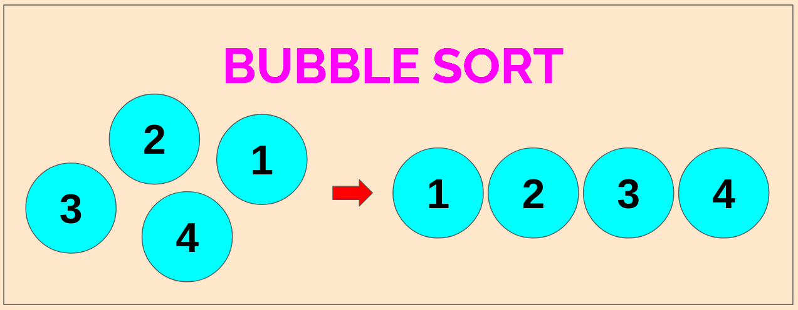
Bubble Sort
Bubble sort is not the best approach for a person to take when we try to sort a collection of items but it's really a good way for beginners to get an idea of how sorting is supposed to work.
Bubble sort is just a way to make a pass through a collection of items and then end up with a completely sorted list.

Slide 3
Program for Bubble Sort
Int[] a = new int [] {8,9,2,5,19,15}
{
for(int i=0;i<a.Length-1;i++)
{
For (int j=0;j<a.Length-i-1;j++)
{
If a[j] > a.[j+1]
{
Int temp=a[j+1]
a[j]=a[j+1]
a[j+1]=temp;
}
foreach(var v in a)
Console.WriteLine(v);
}
}
}

